Slide 1
Panorama da doença her-2 em tumores ginecológicos
Profª. Drª. Karla Kabbach
Patologista do Hospital Israelita Albert Einstein e Professora adjunta do Dept. de Patologia da EPM/UNIFESP e FCMS

Slide 2
Declaração de Conflito de Interesse
De acordo com a resolução 1931/2009 do Conselho Federal de Medicina (CFM) e com a RDC 96/2008 da ANVISA, declaro que:
Sou speaker da AstraZeneca / Daiichi-Sankyo
Não participo de pesquisas clínicas em relação aos temas aqui mencionados
O conteúdo dessa aula é representação de dados obtidos na literatura médica associados às minhas opiniões
Meus pré-requisitos para participar nestas atividades são autonomia de pensamento científico, independência de opinião e liberdade de expressão, aspectos respeitados pelas empresas apoiadoras.

Slide 3

Cronograma
HER-2:
Definições
Métodos diagnósticos
Introdução
Contextualização
HER-2 em tumores ginecológicos
Perspectivas futuras
Interpretação diagnóstica
Terapias-alvo

Slide 4

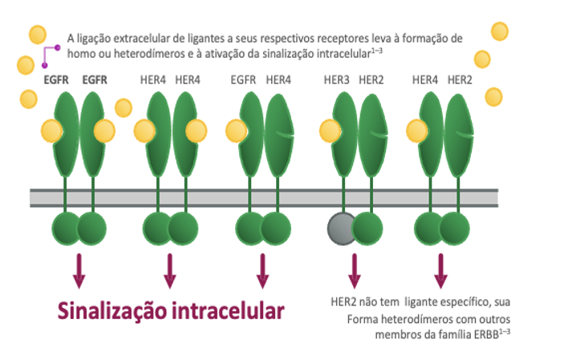
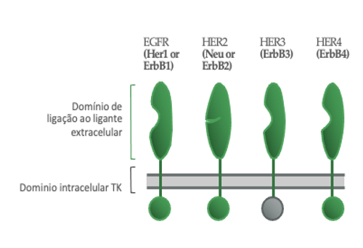
Membros da família ERBB e vias de sinalização
A amplificação do gene HER2 e/ou a superexpressão de membros da família ERBB conduzem a tumorigênese em vários tecidos^{1–5}
ERBB, erythroblastic oncogene B; HER, human epidermal growth factor receptor; HER2, human epidermal growth factor receptor 2
1. Lee Y, et al. Acta Biochim Biophys Sin. 2014;46:190–8; 2. Lyu H, et al. Acta Pharm Sin B. 2018;8:503–10; 3. Arteaga CL, et al. Cancer Cell 2014;25:282–303; 4. Wieduwilt MJ, et al. Cell Mol Life Sci 2008;65:1566–84; 5. Subramanian J, et al. Oncologist 2019;24:e1303– 14; 6. Cai Z, et al. In: Badve S., Kumar G. (eds) Predictive Biomarkers in Oncology. Springer, Cham. pages 231‒42 Grinda T et al. ESMO Open. 202, Hudis CA. N Engl J Med. 2007
Notes:
Receptor de tirosina quinase, membro da família de fatores de crescimento epidérmico
Funções na célula normal :
Regulação do crescimento celular
Síntese proteica
Mobilidade celular
Sobrevivência celular
Regulação do ciclo celular
Domínio extracelular com conformação aberta
Não requer ligante para se tornar ativo
Formação de dímeros
Crescimento celular desordenado
Imortalidade celular
Capacidade de invasão e metástases
Neoformação vascular

Slide 5
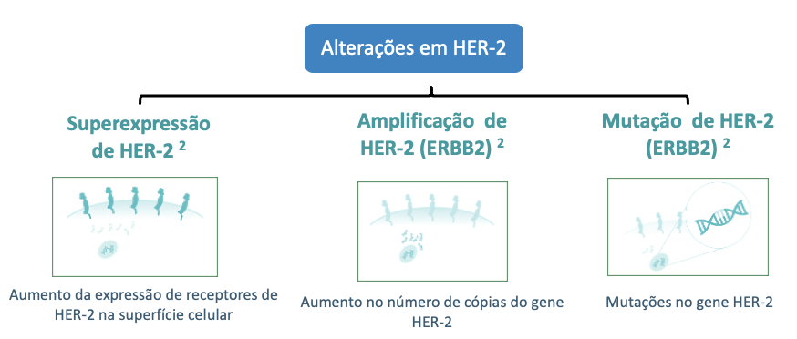
HER-2: superexpressão, amplificação ou mutação
Ativação oncogênica
1. Oh DY et al. Nat Rev Clin Oncol. 2020;17:33–48. 2. Hsu JL et al. Cancer Metastasis Rev. 2016;35:575–588. 3. Daks AA et al. Biochemistry (Mosc). 2020;85:1277–1287. 4. Sun LF et al. Front Oncol. 2020;10:1608.

Slide 6
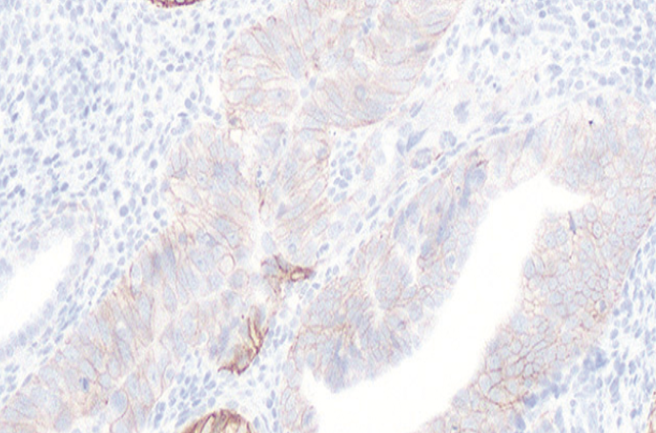
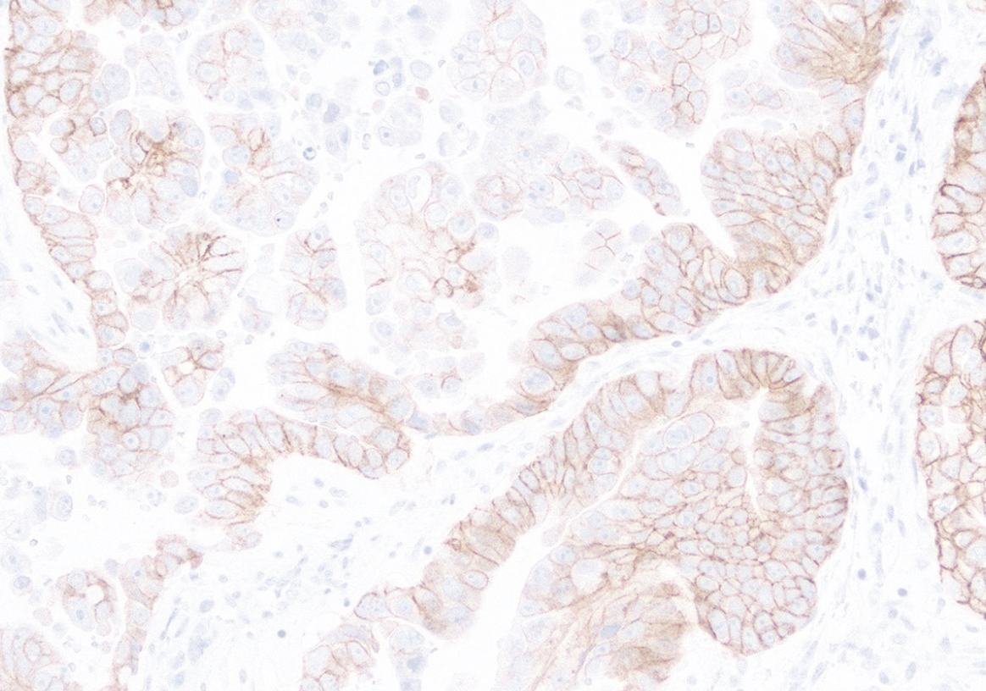
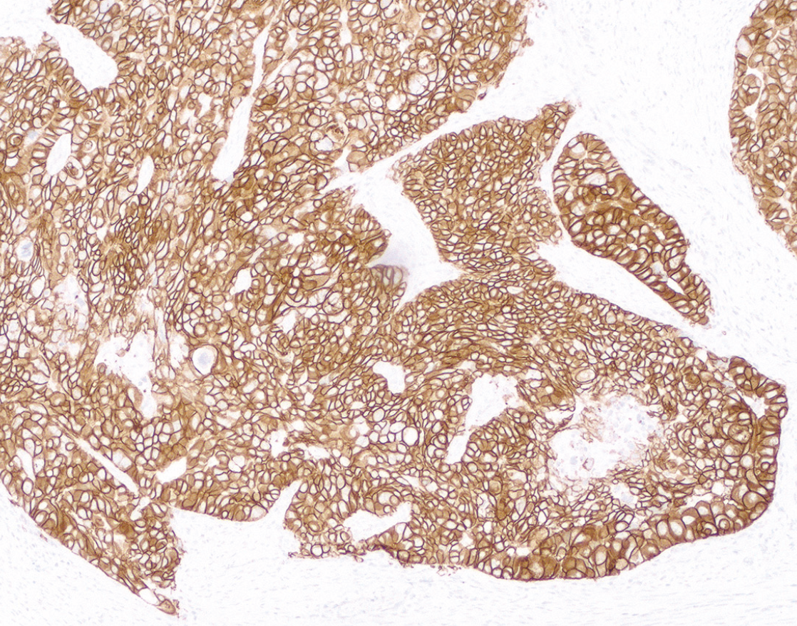
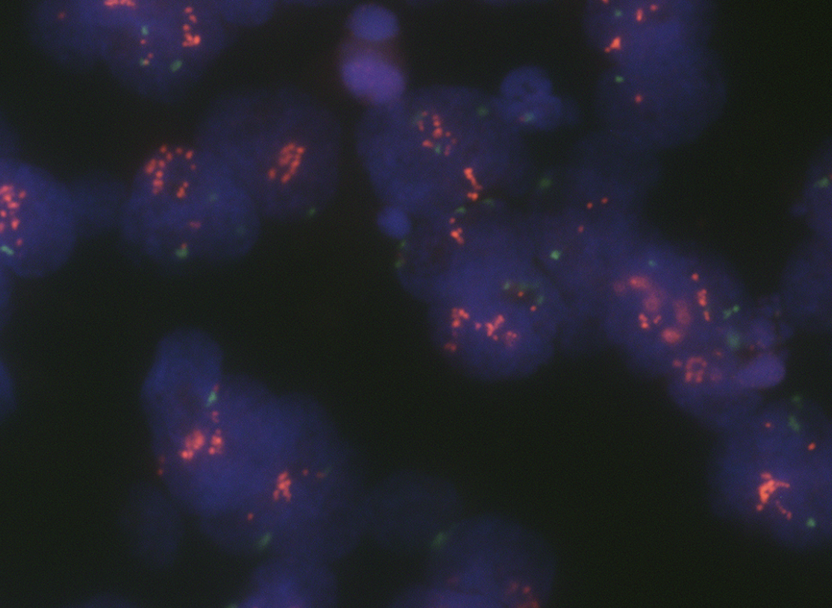
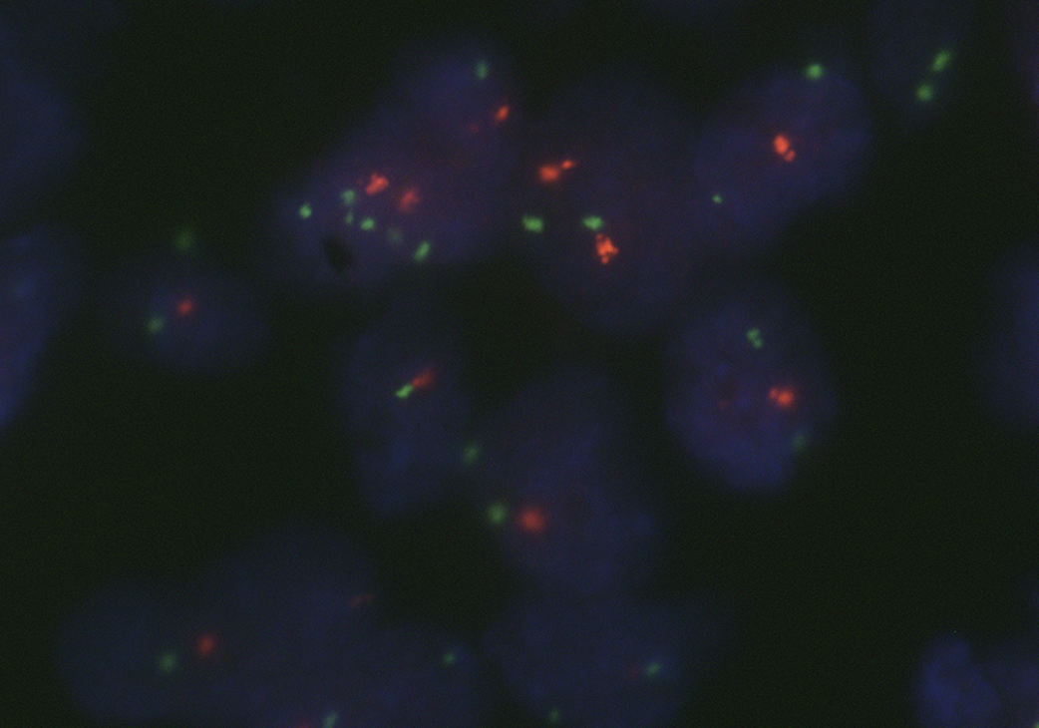

Métodos diagnósticos para alterações em HER-2
Métodos baseados em proteína
Métodos baseados em ácidos nucleicos
 | Superexpressão proteica^{1,6} | Amplificação de HER2 (ERBB2) (número de cópias)^{1,6} | Mutações no gene HER2 (ERBB2)^{4,5,6,a}
Métodos | IHQ | ISH | NGS
Descrição | Avalia nível de expressão proteica¹ Identifica proteína em membrana celular através de anticorpos ¹ Escores de intensidade de marcação, padrão de marcação em membrana e % de células coradas correlaciona-se com quantidade de expressão proteica (IHC 0, 1+, 2+, or 3+) ^{2,a} | Avalia número de cópias do gene HER-2 no núcleo¹ Utiliza sondas de DNA para detector sequências específicas de ácidos nucleicos Técnicas: microscópio fluorescente (FISH), cromogênica (CISH) e or prata (SISH)¹ Define se há amplificação ou não do gene HER-2¹ Testagem em casos de IHC com escore 2¹ | Identifica mutações em HER2 (ERBB2) como parte de perfil molecular mais amplo⁴ Também pode ser usada para detectar amplificações em HER2 (ERBB2)⁵ HER2 (ERBB2) pode ser incluído em painel de genes a serem testados a partir do diagnóstico inicial de câncer⁴
Tipo de amostra | Tecido | Tecido | Tecido Plasma ctDNA^{b}
Alternativas | Espectometria de massa | NGS | ddPCR, qPCR
ªHER2 IHC testing algorithm is based on the intensity of staining and % tumour cells stained; ^{b}Current ctDNA assay sensitivity to detect HER2 (ERBB2) gene amplification in the blood needs to be improved prior to clinical implementation.
1. Furrer D et al. Am J Clin Pathol. 2015;144:686–703. 2. Marchio C et al. Sem Clin Bio. 2021;72:123–135. 3. Zhao J et al. JCO Precis Oncol. 2020;4:411-425. 4. Pennel N et al. Am Soc Clin Oncol Educ Book. 2019;39:531–542. 5. Niu D et al. Pathol Oncol Res. 2020;26:2577–2585. 6. IASLC. IASLC atlas of molecular testing for targeted therapy in lung cancer. https://www.iaslc.org/iaslc-atlas-molecular-testing-targeted-therapy-lung-cancer.

Slide 7
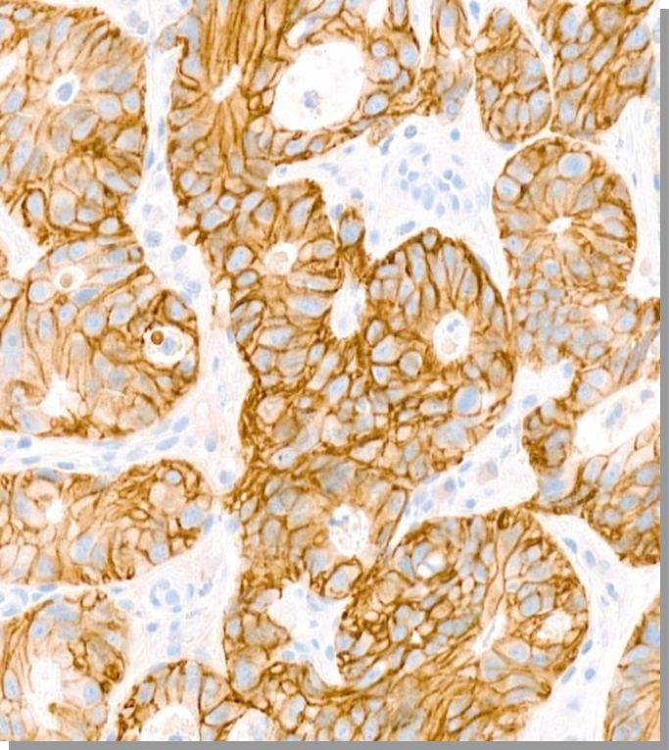
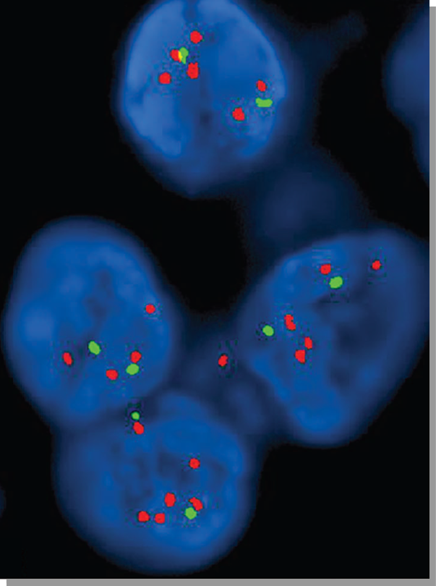
Ensaios aprovados pela FDA
IMUNO-HISTOQUÍMICA
HIBRIDIZAÇÃO IN SITU
HercepTest (A085; Dako)
Pathway anti-HER2 (4B5; Ventana)
Bond Oracle (CB11; Leica)
FISH:
  PathVysion (Abott)
  HER2 FISH PharmaDX (Dako)
Dual ISH
  Inform HER2 (Ventana)
Buza N. HER2 Testing and Reporting in Endometrial Serous Carcinoma: Practical Recommendations for HER2 Immunohistochemistry and Fluorescent In Situ Hybridization: Proceedings of the ISGyP Companion Society Session at the 2020 USCAP Annual Meeting. Int J Gynecol Pathol. 2021

Slide 8
HER-2 em carcinomas endometriais
Interesse em carcinomas endometriais não é novo…
1990-2010:
Superexpressão proteica: 14-80%
Amplificação gênica: 21-47%
Estudos apresentavam alta variabilidade em testagem, critérios de interpretação (escore) e seleção de casos
Alguns relatos de casos com sucesso de tratamento com terapias anti-HER2
2010: clinical trial GOG 181B
Buza N. HER2 Testing and Reporting in Endometrial Serous Carcinoma: Practical Recommendations for HER2 Immunohistochemistry and Fluorescent In Situ Hybridization: Proceedings of the ISGyP Companion Society Session at the 2020 USCAP Annual Meeting. Int J Gynecol Pathol. 2021 Jan;40(1):17-23. doi: 10.1097/PGP.0000000000000711.; Buza N. HER2 Testing in Endometrial Serous Carcinoma: Time for Standardized Pathology Practice to Meet the Clinical Demand. Arch Pathol Lab Med. 2021 Jun 1;145(6):687-691. doi: 10.5858/arpa.2020-0207-RA. PMID: 32649220.

Slide 9
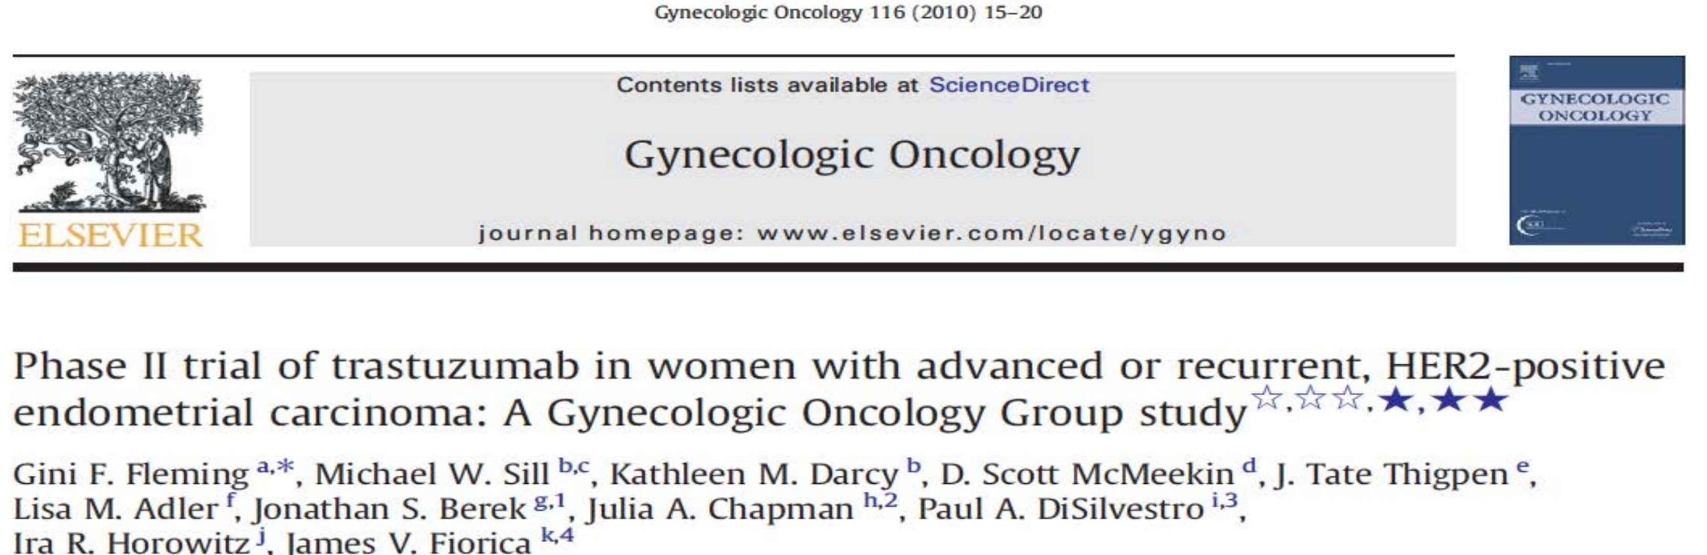
Trastuzumabe como agente único para tratamento de carcinomas endometriais avançados ou recorrentes HER-2 (+)
33 pacientes com tumores HER-2 (+): 11 serosos, 13 endometrioides, 2 células claras, 5 mistos e 1 SOE
Critérios de interpretação: escores de câncer de mama (ASCO/CAP 2007)
IHQ escore 2+ ou 3+, ou razão > 2.0 no FISH
Trial fechado precocemente por provisão de reservas
Buza N. HER2 Testing and Reporting in Endometrial Serous Carcinoma: Practical Recommendations for HER2 Immunohistochemistry and Fluorescent In Situ Hybridization: Proceedings of the ISGyP Companion Society Session at the 2020 USCAP Annual Meeting. Int J Gynecol Pathol. 2021 Jan;40(1):17-23. doi: 10.1097/PGP.0000000000000711.; Buza N. HER2 Testing in Endometrial Serous Carcinoma: Time for Standardized Pathology Practice to Meet the Clinical Demand. Arch Pathol Lab Med. 2021 Jun 1;145(6):687-691. doi: 10.5858/arpa.2020-0207-RA. PMID: 32649220.

Slide 10
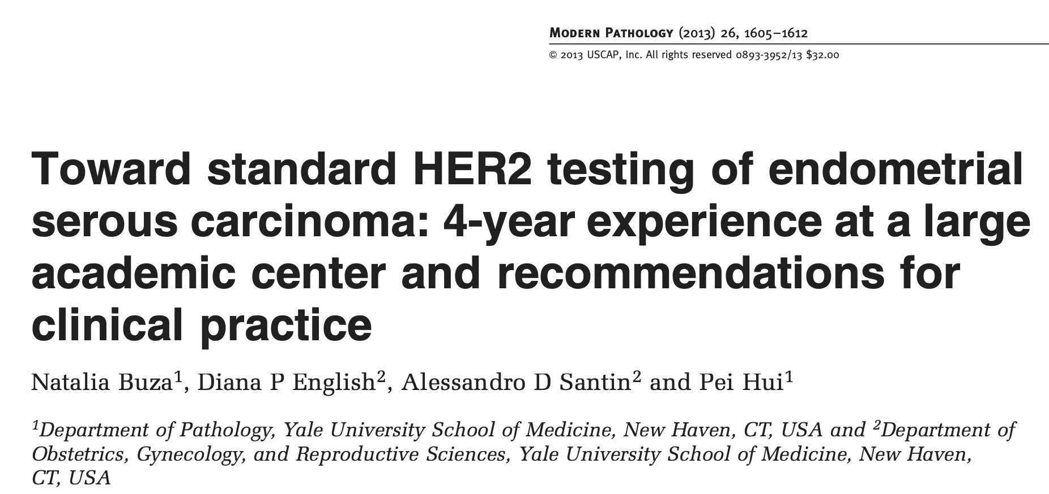
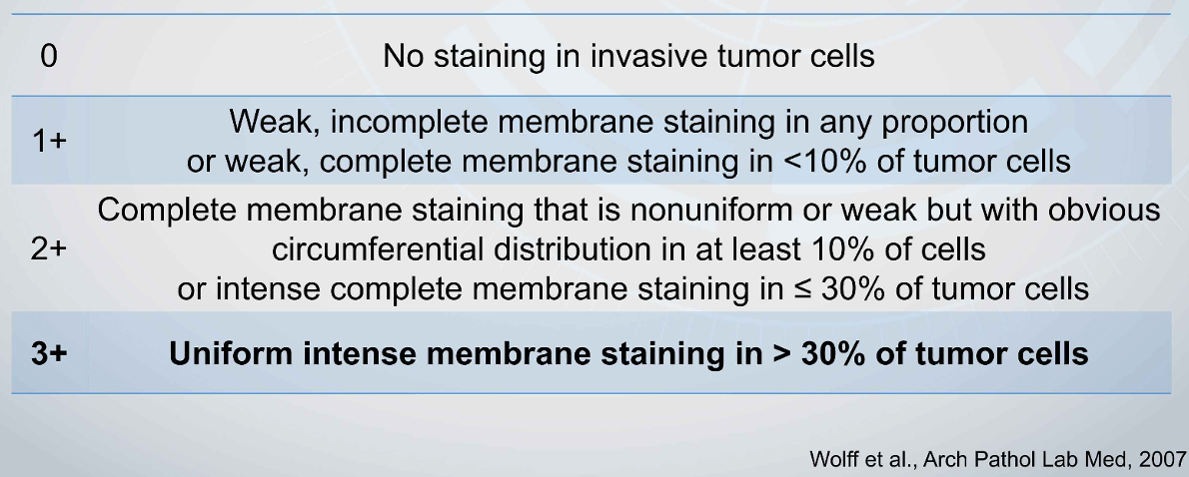
HER-2 em carcinomas endometriais
108 casos: 85 carcinomas serosos e 23 carcinomas mistos com componente seroso
HER2 IHQ (Herceptest, Dako)
HER2 FISH em casos duvidosos (escore 2) e em alguns casos HER2 0, 1 e 3+ (PathVysion)
Escores de IHQ baseados nos critérios de cancer de mama (ASCO/CAP, 2007)
Amplificação de HER-2: HER2/CEP17 ≥ 2.0
Concordância IHQ-FISH:
  Todos os casos de IHQ: 81%
  Excluindo escore 2+: 86%
Buza N. HER2 Testing and Reporting in Endometrial Serous Carcinoma: Practical Recommendations for HER2 Immunohistochemistry and Fluorescent In Situ Hybridization: Proceedings of the ISGyP Companion Society Session at the 2020 USCAP Annual Meeting. Int J Gynecol Pathol. 2021 Jan;40(1):17-23. doi: 10.1097/PGP.0000000000000711.; Buza N. HER2 Testing in Endometrial Serous Carcinoma: Time for Standardized Pathology Practice to Meet the Clinical Demand. Arch Pathol Lab Med. 2021 Jun 1;145(6):687-691. doi: 10.5858/arpa.2020-0207-RA. PMID: 32649220.

Slide 11
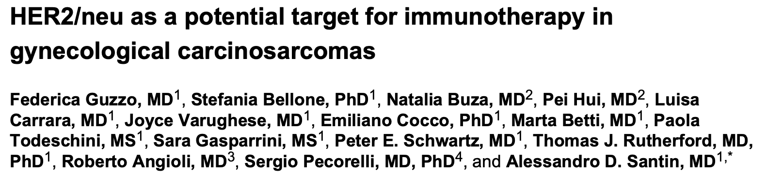
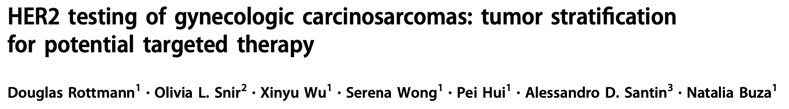
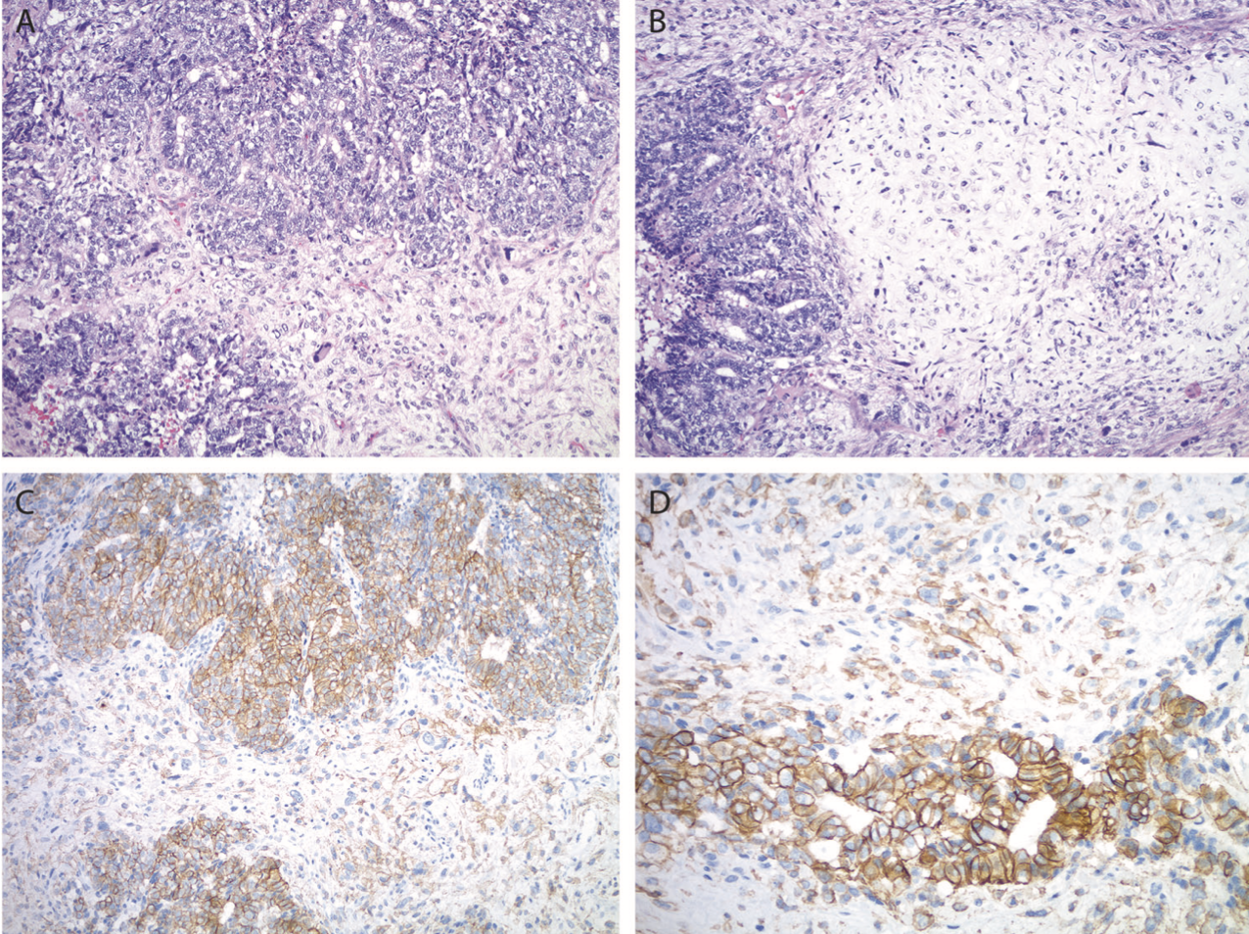
HER-2 em carcinomas endometriais
2012: estudo com cultura in vitro de células de carcinossarcomas primários de útero e ovário → primeira demonstração de potencial uso terapêutico de trastuzumabe
2020: 80 pacientes (65 uterinos e 15 tubo-ovarianos)
Componente carcinomatoso: 13-16% HER2(+)
Componente sarcomatoso: 5 casos escore 2+ com FISH amplificado
Rottmann D, Snir OL, Wu X, Wong S, Hui P, Santin AD, Buza N. HER2 testing of gynecologic carcinosarcomas: tumor stratification for potential targeted therapy. Mod Pathol. 2020 Jan;33(1):118-127.
Guzzo F, Bellone S, Buza N, Hui P, Carrara L, Varughese J, Cocco E, Betti M, Todeschini P, Gasparrini S, Schwartz PE, Rutherford TJ, Angioli R, Pecorelli S, Santin AD. HER2/neu as a potential target for immunotherapy in gynecologic carcinosarcomas. Int J Gynecol Pathol. 2012 May;31(3):211-21..
Notes:
multiple primary ovarian and uterine MMT cell lines - primary tumor cell lines in vitro and evaluated for HER2/neu expression by immunohistochemistry (IHC), fluorescent-in-situ-hybridization-analysis (FISH), quantitative-real-time-polymerase-chain-reaction and for membrane-bound-complement- regulatory-proteins (mCRP) CD46, CD55 and CD59 by flow-cytometry. Our results suggest that HER2/neu may represent a novel target for the immunotherapy of a subset of human carcinosarcomas refractory to salvage chemotherapy. In conclusion, this is the first report on HER2/neu gene and protein expression in primary MMT cell lines and the first demonstration of trastuzumab-mediated antibody-dependent cellular cytotoxicity against uterine and ovarian carcinosarcomas in vitro. Although in vivo data will ultimately be necessary to validate the therapeutic potential of trastuzumab against HER2/neu expressing carcinosarcomas, our in vitro results strongly suggest that targeting cancer cells with high surface expression of HER2/neu can be an attractive and novel strategy to treat residual and/or resistant gynecologic carcinosarcomas refractory to salvage chemotherapy.
We aimed to systematically evaluate the characteristics of HER2 expression/amplification in gynecologic carcinosarcomas using standardized staining methods and scoring criteria. Tumors from 80 patients (65 uterine, 15 tubo-ovarian) were included, containing a serous (60%), endometrioid (10%), clear cell (3%), undifferentiated (3%), neuroendocrine (1%), or mixed (24%) carcinoma, and either a homologous (46%), or a heterologous (54%) sarcoma component.
HER2 scores were assigned to both components per the 2007 and 2013 ASCO/CAP breast scoring criteria. A total of 13 cases (12 uterine, 1 ovarian, 16%) were HER2 positive (either by immunohistochemistry or FISH) using the 2013 criteria, while only 10 cases (9 uterine, 1 ovarian, 13%) were HER2 positive per the 2007 criteria. The sarcoma component showed 2+, equivocal HER2 expression in five cases, one of which also demonstrated HER2 amplification by FISH. All HER2-positive carcinosarcomas had either a serous or a mixed carcinoma componente. Our study demonstrates that gynecologic carcinosarcomas share similarities in their HER2 expression/amplification profiles to endometrial serous carcinomas, which should be taken into account when assessing their HER2 status to ensure appropriate patient selection for potential targeted HER2-based therapies in the future.

Slide 12
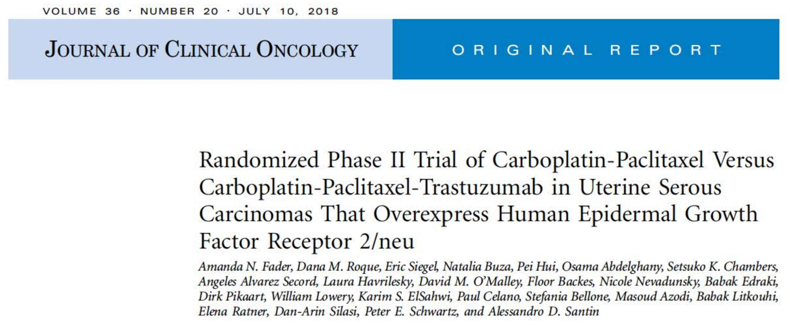
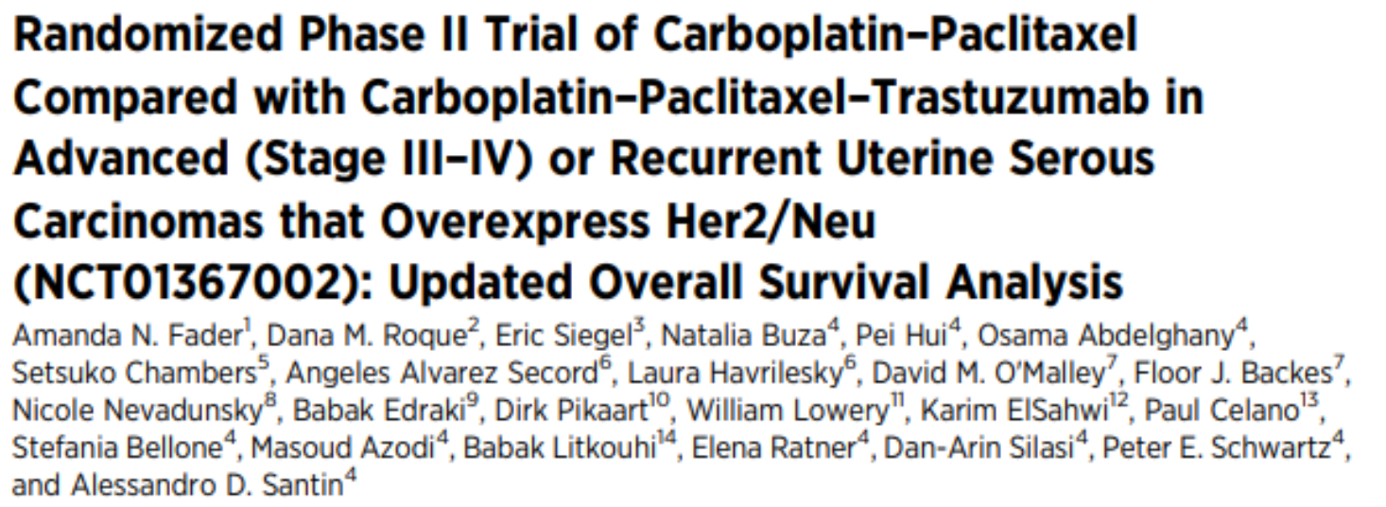
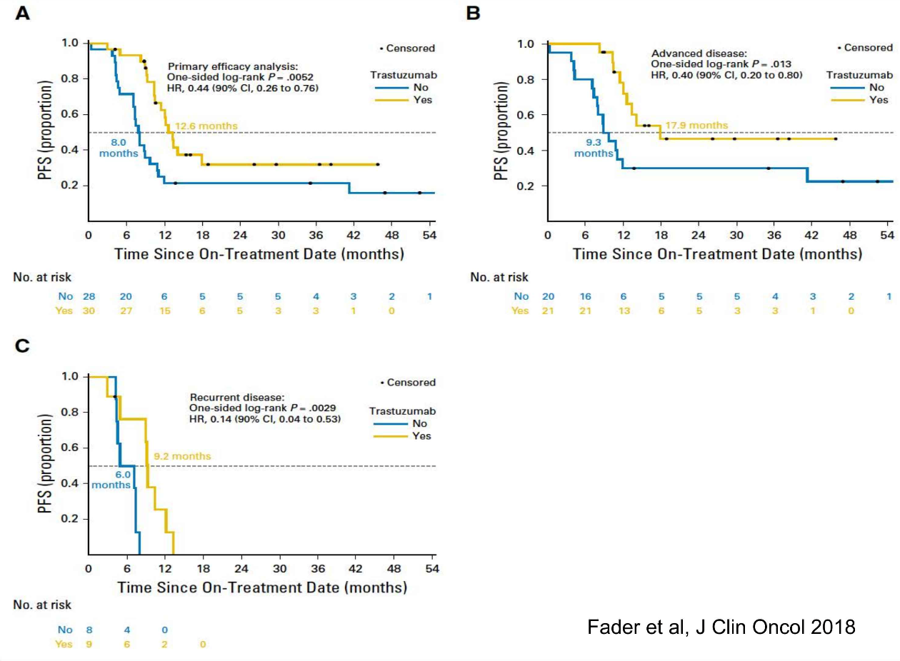
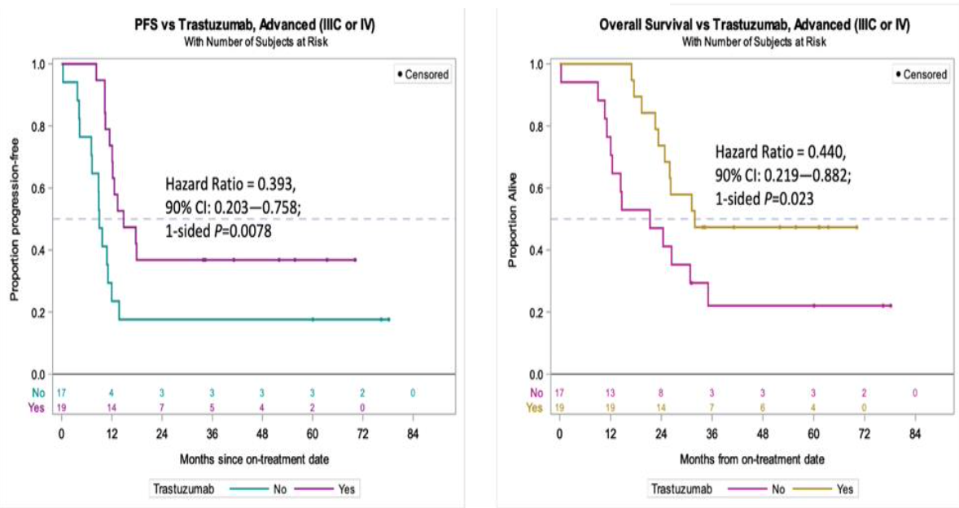
Notes:
Phase II clinical trial: 58 patients with primary stage III or IV or recurrent HER2-positive disease randomly assigned to receive carboplatin-paclitaxel (control arm) with or
without the anti-HER2 medication trastuzumab (experimental arm) until progression or unacceptable toxicity.
•Median progression-free survival was 8.0 months (control) versus 12.6 months (experimental; P = .005; hazard ratio [HR], 0.44; 90% CI, 0.26 to 0.76).
OS was higher in the T compared to the control arm, with medians of 29.6 versus 24.4-months, (HR 0.58; 90%CI 0.34– 0.99; P=0.046). The benefit was most notable in those with
stage III-IV disease.
Fader AN, Roque DM, Siegel E, Buza N, Hui P, Abdelghany O, Chambers SK, Secord AA, Havrilesky L, O'Malley DM, Backes F, Nevadunsky N, Edraki B, Pikaart D, Lowery W, ElSahwi KS, Celano P, Bellone S, Azodi M, Litkouhi B, Ratner E, Silasi DA, Schwartz PE, Santin AD. Randomized Phase II Trial of Carboplatin-Paclitaxel Versus Carboplatin-Paclitaxel-Trastuzumab in Uterine Serous Carcinomas That Overexpress Human Epidermal Growth Factor Receptor 2/neu. J Clin Oncol. 2018 Jul 10;36(20):2044-2051. doi: 10.1200/JCO.2017.76.5966. Epub 2018 Mar 27. PMID: 29584549.

Slide 13

HER-2 em carcinomas endometriais
Guidelines NCCN, 2019
Regime de preferência de QT para pacientes com carcinoma serosos e carcinossarcomas de endométrio HER-2 (+) em estadiamentos avançados (III/IV) or recorrentes:
Carboplatina/ paclitaxel/ trastuzumabe
NCCN Clinical Practice Guidelines in Oncology (NCCN Guidelines) – Prevention and Treatment of Cancer-Related Infections. 2012;10:1412- 1445 J Natl Compr Canc Netw.

Slide 14
Linha do tempo
Pertuzumabe aprovado para câncer de mama
Trastuzumabe aprovado para câncer de mama
Trastuzumabe aprovado para câncer gástrico
T-DM1 aprovado para câncer de mama
Trastuzumabe melhora PFS e OS em carcinomas serosos de endométrio
GOG 181B trial
Trastuzumabe como agente único em câncer endometrial
Buza N. HER2 Testing and Reporting in Endometrial Serous Carcinoma: Practical Recommendations for HER2 Immunohistochemistry and Fluorescent In Situ Hybridization: Proceedings of the ISGyP Companion Society Session at the 2020 USCAP Annual Meeting. Int J Gynecol Pathol. 2021 Jan;40(1):17-23. doi: 10.1097/PGP.0000000000000711.; Buza N. HER2 Testing in Endometrial Serous Carcinoma: Time for Standardized Pathology Practice to Meet the Clinical Demand. Arch Pathol Lab Med. 2021 Jun 1;145(6):687-691. doi: 10.5858/arpa.2020-0207-RA. PMID: 32649220.

Slide 15
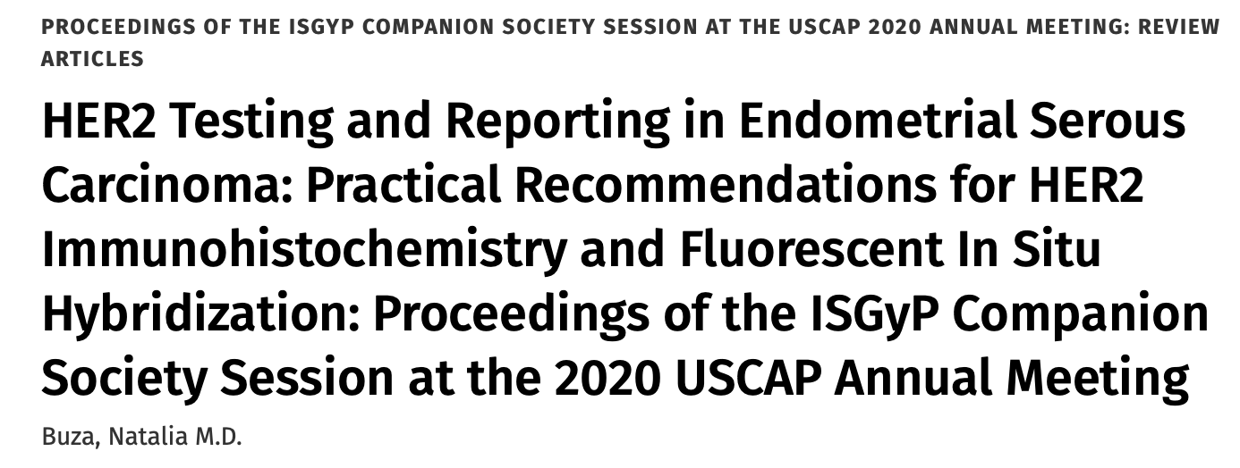

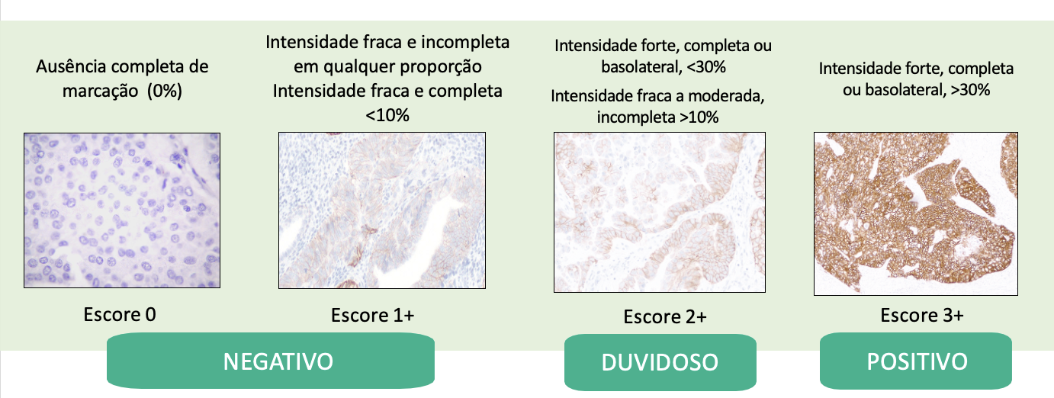
Baseado em modificação dos critérios ASCO/CAP 2007 de mama
Buza N. HER2 Testing and Reporting in Endometrial Serous Carcinoma: Practical Recommendations for HER2 Immunohistochemistry and Fluorescent In Situ Hybridization: Proceedings of the ISGyP Companion Society Session at the 2020 USCAP Annual Meeting. Int J Gynecol Pathol. 2021 Jan;40(1):17-23. doi: 10.1097/PGP.0000000000000711.; Buza N. HER2 Testing in Endometrial Serous Carcinoma: Time for Standardized Pathology Practice to Meet the Clinical Demand. Arch Pathol Lab Med. 2021 Jun 1;145(6):687-691. doi: 10.5858/arpa.2020-0207-RA. PMID: 32649220.
Notes:
Algoritmo proposto inicialmente para carcinomas serosos baseou-se na concordância entre IH e ISH

Slide 16
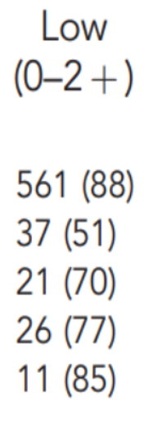
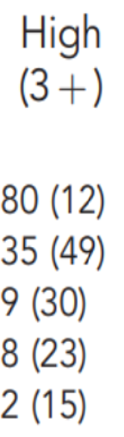
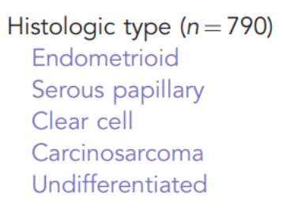
Alterações em HER-2 não são específicas de carcinomas serosos do endométrio
Dados baseados em população norueguesa: 790 casos
Prevalência de HER-2 (+) por IHQ (Herceptest) em diferentes tipos histológicos:
Halle et al. Br J Cancer. 2018 Feb 6; 118(3): 378–387.

Slide 17
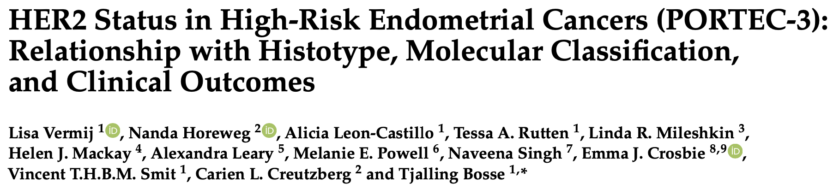
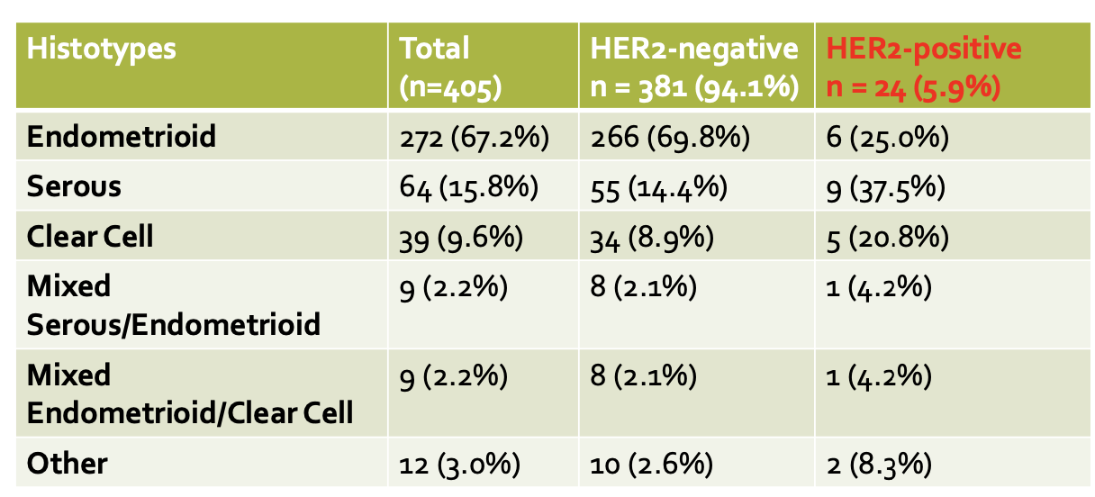
Vermij L, Horeweg N, Leon-Castillo A, Rutten TA, Mileshkin LR, Mackay HJ, Leary A, Powell ME, Singh N, Crosbie EJ, Smit VTHBM, Creutzberg CL, Bosse T. HER2 Status in High-Risk Endometrial Cancers (PORTEC-3): Relationship with Histotype, Molecular Classification, and Clinical Outcomes. Cancers (Basel). 2020 Dec 25;13(1):44. doi: 10.3390/cancers13010044. PMID: 33375706; PMCID: PMC7795222.

Slide 18
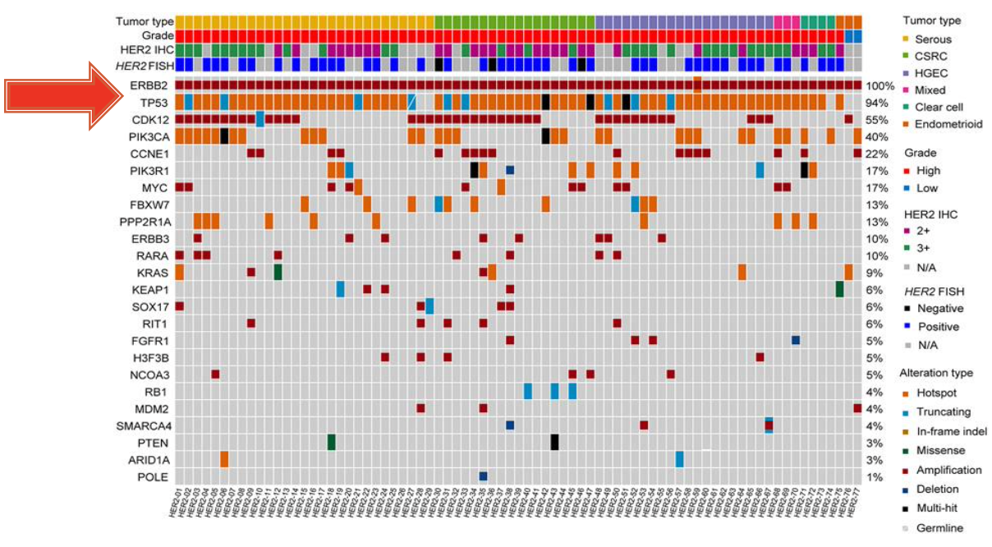
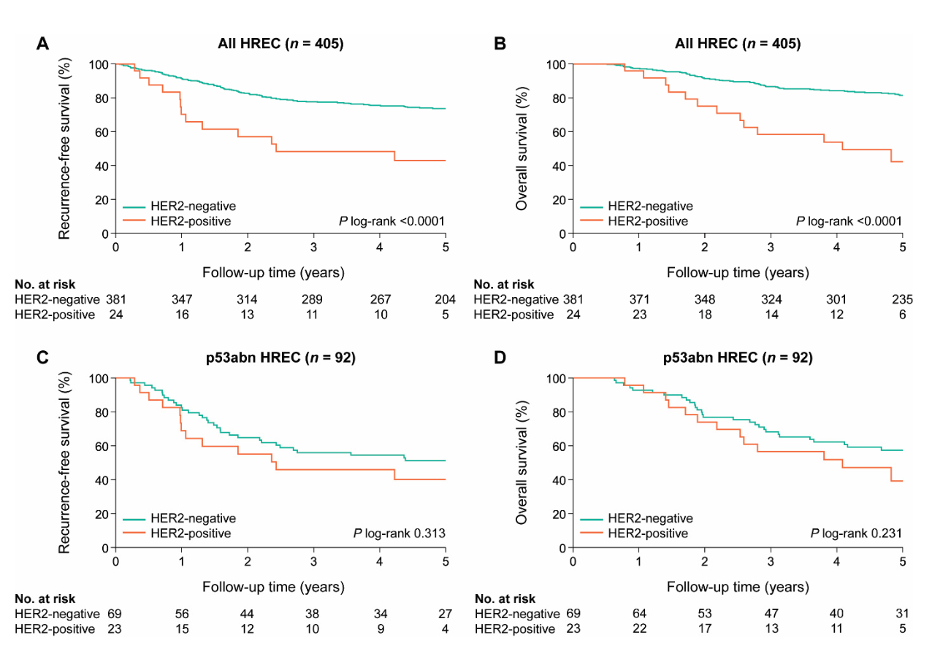
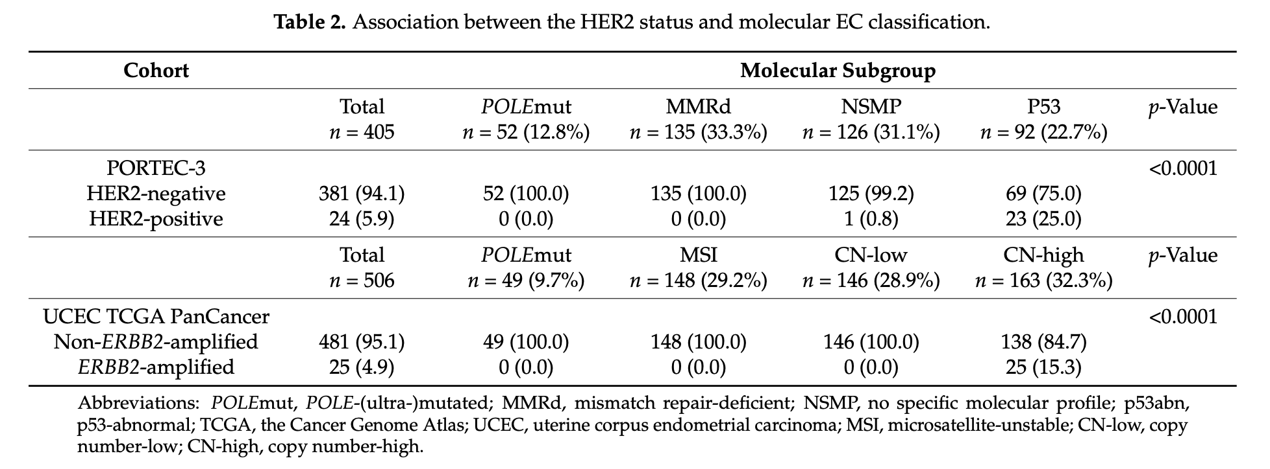
HER2 (+): 94% têm mutação em TP53
“Alto número de cópias/ TP53 mutado”: 20-25% são HER2 (+)
Vermij L, Horeweg N, Leon-Castillo A, Rutten TA, Mileshkin LR, Mackay HJ, Leary A, Powell ME, Singh N, Crosbie EJ, Smit VTHBM, Creutzberg CL, Bosse T. HER2 Status in High-Risk Endometrial Cancers (PORTEC-3): Relationship with Histotype, Molecular Classification, and Clinical Outcomes. Cancers (Basel). 2020 Dec 25;13(1):44. doi: 10.3390/cancers13010044. PMID: 33375706; PMCID: PMC7795222.
Notes:
Patients with HER2-positive EC had significantly poorer survival than patients with HER2-negative EC (5-year RFS: 42.9% vs. 73.6%, p < 0.0001; 5-year OS: 42.3% vs. 81.4%, p < 0.0001) (Figure 3A,B). However, in a sub- analysis including only p53abn EC, there was no difference in prognosis (Figure 3C,D). The prognostic value of the HER2 status was evaluated in univariable and multivariable analy- sis including all PORTEC-3 patients (Table 3). In univariable analysis, HER2 positivity was associated with significantly worse recurrence-free survival (HR: 2.76; 95% CI:1.55–4.93) and overall survival (HR: 3.64; 95% CI: 2.02–6.58). However, when corrected for age, stage, grade, LVSI, and the molecular classification by multivariable analysis, HER2 status was not an independent prognostic factor for both RFS (HR: 1.15; 95% CI: 0.60–2.12) and OS (HR: 1.24; 95% CI: 0.63–2.42).
HER2 positivity has negative prognostic value in high
risk endometrial cancers, but probably NOT in the p53
abn/CN-high molecular subclass of this group

Slide 19

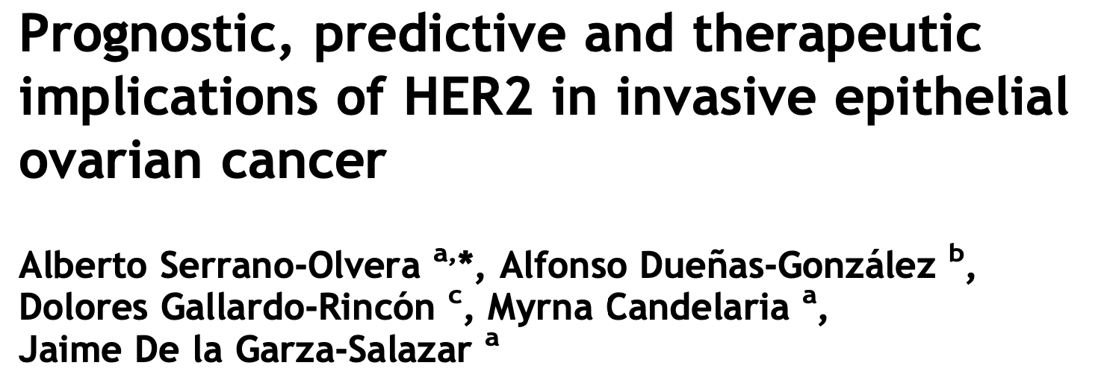

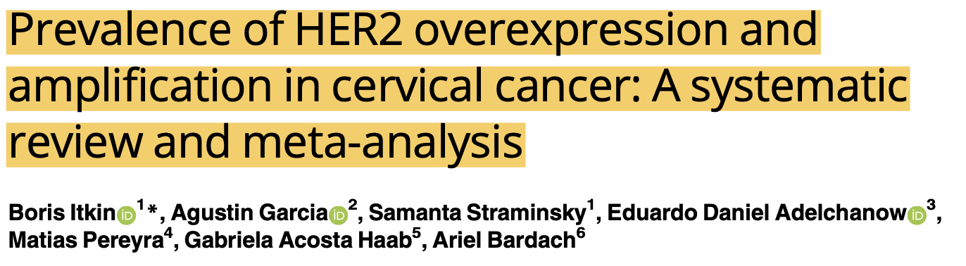
HER-2 em ovário e colo uterino
HER-2 superexpresso e amplificado em 6,6% dos casos
67,5% HGSC
Impacto prognóstico adverso
HER-2 superexpresso (IH):
  23% mucinosos, 19% células claras, 18% HGSC e 10% endometrioide
Fator prognóstico independente de impacto na sobrevida
Melhor resposta à QT relacionada a menor número de cópias gênicas (<2)
HER-2 superexpresso entre 1,8-35% dos casos
Estadiamento avançado, tumor residual pós tratamento, histologia de alto grau, maior recorrência, menor sobrevida global e menor sensibilidade à QT baseada em platina
Carcinoma mucinoso: HER-2 amplificado em 18,2 a 35,3%
65 estudos → HER-2 superexpresso em 0-87%
Biópsias e peças cirúrgicas
Tumor primário, linfonodos, recorrência e/ou metástases
Histologia escamosa: 4,1% HER-2 (+)
Histologia não escamosa: 10,3% HER-2 (+)
Notes:
In this study, HER2 gene status was evaluated in a large, multicentric series of 320 patients with advanced ovarian cancer, including 243 patients enrolled in a multicenter prospective clinical trial of paclitaxel/carboplatin-based chemotherapy. HER2 gene was overexpressed and amplified in 6.6% of analyzed tumors. HER2-positive status did not influence outcome in the present study, possibly due to the fact that patients in our study received paclitaxel/carboplatin-based chemotherapy. This raises the question of whether HER2 status and paclitaxel sensitively are linked. 67,5% eram serosos hg.
An adverse prognostic impact of HER2 overexpression and/or amplification has been shown in most of the published series
HER2 overexpression has been associated with advanced stages, poorly differentiated tumors, resistance to chemotherapy and shortened survival. Although trastuzumab is able to produce a low response rate as a single agent in pretreated ovarian cancer patients with overexpression of HER2, its usefulness is limited due to the low frequency of strong expression. To date there is not enough bases for assess- ment and HER2-based therapies in epithelial ovarian cancer.
different histological types, detected 10% of HER2 overexpression by IHC in cases with endomet- roid type, and 18% of positivity by FISH was noted only in patients with serous type. more frequently observed is the overexpression in serous neoplasm. In one study with a large population, Clover et al.56 reported that the mucinous and clear cell varieties overexpress HER2 more frequently (23% and 19%, respectively).
expression status of HER2 in hereditary vs. sporadic ovarian cancer, Auranen et al.35 found no statistically significant difference.
Multivariate analysis confirmed the HER2 expression as a survival inde- pendent prognostic factor
the response rate to chemotherapy was re- lated to gene copy number, as estimated by CISH, with a response rate of 78% in cases with less than 2 copies, 63% with 3–5 copies and 62% in cases with more than 5 gene copies of HER2.
In epithelial ovarian cancer, strong expression frequency varies between 1.8% and 35%, and it seems that it is associated with ad- vanced stages, higher frequency of surgical resid- ual tumor larger than 2cm, poor histological grade, higher recurrence frequency and shorter survival time, as well as with lower sensitivity to platinum-based chemotherapy.
It is difficult to come to a consensus with HER2 as a prognostic factor as the methodol- ogies behind the trials in addition to the patient population and histol- ogies all differ.
The mucinous cancer subtypes account for 2% to 5% of EOCs and beyond stage I, show less responsiveness to chemotherapy and worse prognoses; they show a higher percentage of HER2 amplification, varying from 18.2% to 35.3% in studies [2,28–31]. Among the major histopathologic EOC sub- types, mucinous carcinomas have the highest prevalence of HER2 am- plification [28,32]. In a study of 85 ovarian tumors, 17 of which were mucinous, HER2 positivity was only seen in the mucinous subtype [30].
Similar to the serous subtypes, correlation between HER2 and prog- nosis in mucinous carcinomas was also variable.
meta-ana- lytic systematic review - descriptive analyses of all 65 included studies
HER2 positivity in cervical cancer (CC) range from 0% to 87% --- High hetero- geneity was the main limitation of the study. Variations in previously reported HER2 positiv- ity rates are mainly related to methodological issues.
In 14 studies (28.6%), tissue for the analyses was obtained by biopsy, in 25 (51.0%) by surgery, and the remaining ten studies (20.4%) used samples from either biopsy or surgery combined in varied proportions. The primary tumor was the exclusive sampling site in 41 (91.1%) stud- ies. In the other 4 (8.9%) studies, in addition to the primary tumor, samples from nodes or dis- tant or local recurrences were included. No study provided sampling-to-fixation and fixation- to-assay times. Data on histologic subtypes were available from 63 (96.9%) studies. Eighteen studies (28.6%) included patients with squamous carcinoma, 18 (28.6%) non-squamous histol- ogy, and 27 (42.9%) studies with both.
In the squamous histology subgroup (12 studies, N = 1018), the esti- mated pooled prevalence of HER2 overexpression was 4.1% (CI 95%: 0.6% to 9.8%), I2 = 91%, while in the non-squamous carcinoma studies (15 studies, N = 467) it was 10.3%
online genomic databases. For example, in the curated datasets of non-redundant studies from the cBioPortal database, HER2 amplified tumors are 5.6% of all CC, 10.9% cervical adenocarci- nomas, and 2.8% of squamous CC
Of note, the ASCO/CAP guidelines for breast cancer were developed largely based on the benefit of trastuzumab. If new drugs active in patients with HER2-low-expressing tumors become available, the proportion of CC patients with this potentially relevant actionable target may increase

Slide 20
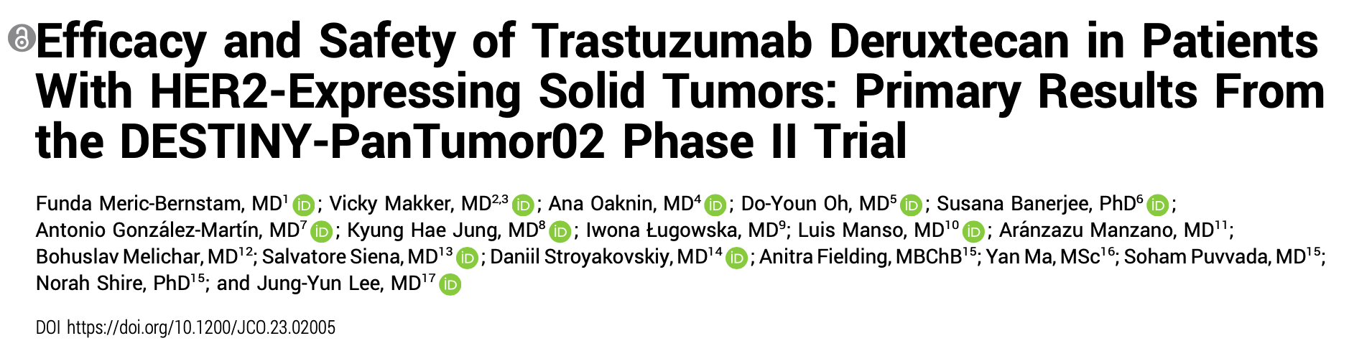
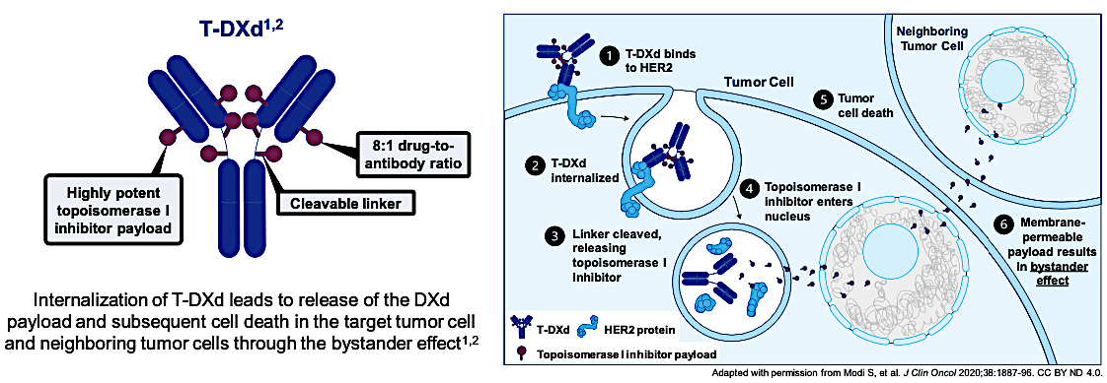
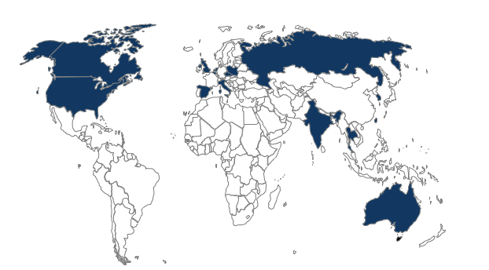
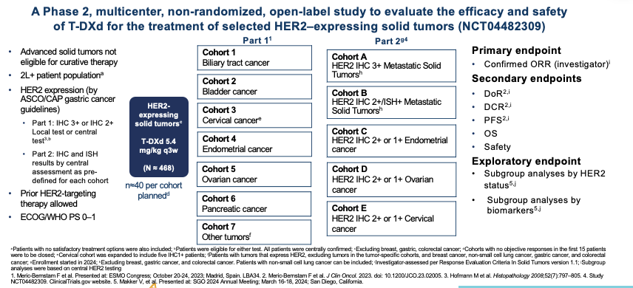
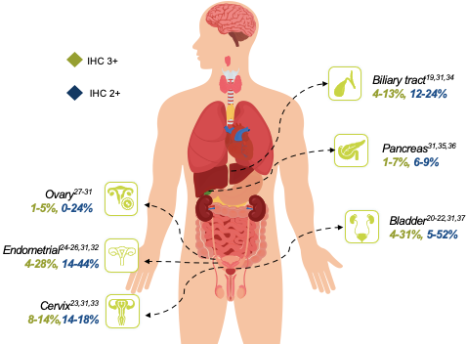
Meric-Bernstam F, Makker V, Oaknin A, Oh DY, Banerjee S, González-Martín A, Jung KH, Ługowska I, Manso L, Manzano A, Melichar B, Siena S, Stroyakovskiy D, Fielding A, Ma Y, Puvvada S, Shire N, Lee JY. Efficacy and Safety of Trastuzumab Deruxtecan in Patients With HER2-Expressing Solid Tumors: Primary Results From the DESTINY-PanTumor02 Phase II Trial. J Clin Oncol. 2024 Jan 1;42(1):47-58. doi: 10.1200/JCO.23.02005. Epub 2023 Oct 23. PMID: 37870536; PMCID: PMC10730032.
Notes:
15 países
Key Takeaways:
Eligibility was based on local HER2 IHC assessment or central testing if local testing was not feasible
HER2 IHC status for each patient was confirmed retrospectively by central testing
Analyses were performed using both data sets
Subgroup analyses by IHC status were performed using central test results.
Investigator assessments per Response Evaluation Criteria In Solid Tumors version 1.1 was used for ORR, DoR, DCR, PFS
DCR, disease control rate; DoR, duration of response; EC, endometrial cancer; ECOG, Eastern Cooperative Oncology Group; ORR, overall response rate; OS, overall survival; PFS, progression-free survival; PS, performance status; RECIST, Response Evaluation Criteria in Solid Tumors; T-DXd, trastuzumab deruxtecan; tx, treatment.

Slide 21
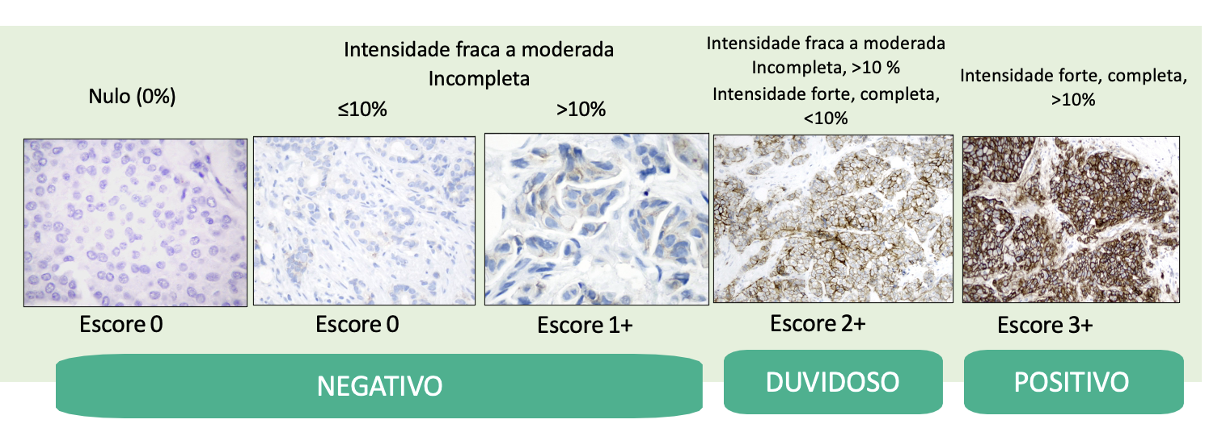
Interpretação IHQ proposta (DPT-02)
Protocolo gástrico
Hofmann M, Stoss O, Shi D, Büttner R, van de Vijver M, Kim W, Ochiai A, Rüschoff J, Henkel T. Assessment of a HER2 scoring system for gastric cancer: results from a validation study. Histopathology. 2008 Jun;52(7):797-805. doi: 10.1111/j.1365-2559.2008.03028.x. Epub 2008 Apr 18.
Rüschoff J, Dietel M, Baretton G, Arbogast S, Walch A, Monges G, Chenard MP, Penault-Llorca F, Nagelmeier I, Schlake W, Höfler H, Kreipe HH. HER2 diagnostics in gastric cancer-guideline validation and development of standardized immunohistochemical testing. Virchows Arch. 2010 Sep;457(3):299-307. doi: 10.1007/s00428-010-0952-2. Epub 2010 Jul 28. PMID: 20665045; PMCID: PMC2933810.

Slide 22
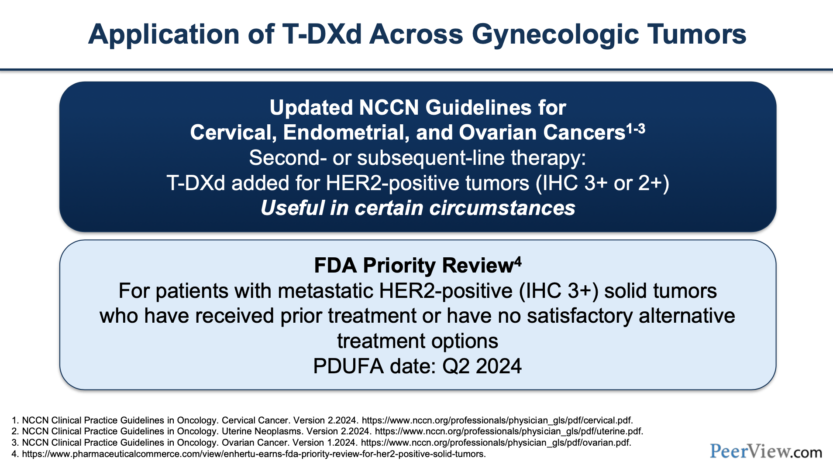
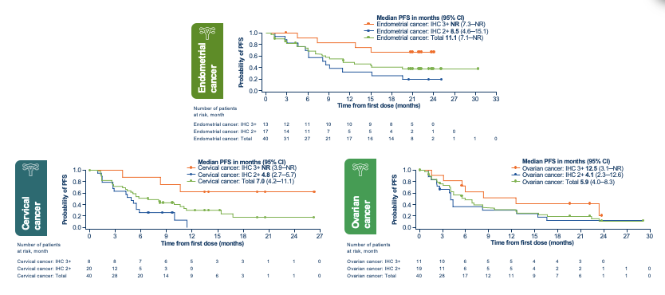
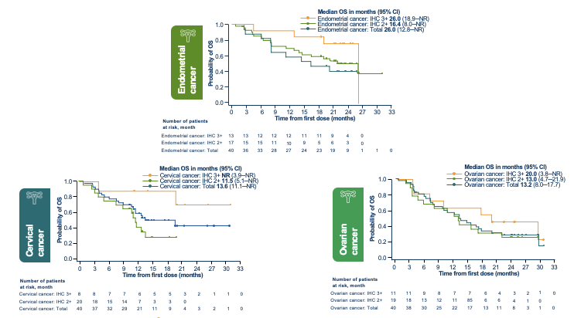
Curvas de sobrevida por status de HER-2
Meric-Bernstam F, Makker V, Oaknin A, Oh DY, Banerjee S, González-Martín A, Jung KH, Ługowska I, Manso L, Manzano A, Melichar B, Siena S, Stroyakovskiy D, Fielding A, Ma Y, Puvvada S, Shire N, Lee JY. Efficacy and Safety of Trastuzumab Deruxtecan in Patients With HER2-Expressing Solid Tumors: Primary Results From the DESTINY-PanTumor02 Phase II Trial. J Clin Oncol. 2024 Jan 1;42(1):47-58. doi: 10.1200/JCO.23.02005. Epub 2023 Oct 23. PMID: 37870536; PMCID: PMC10730032.

Slide 23
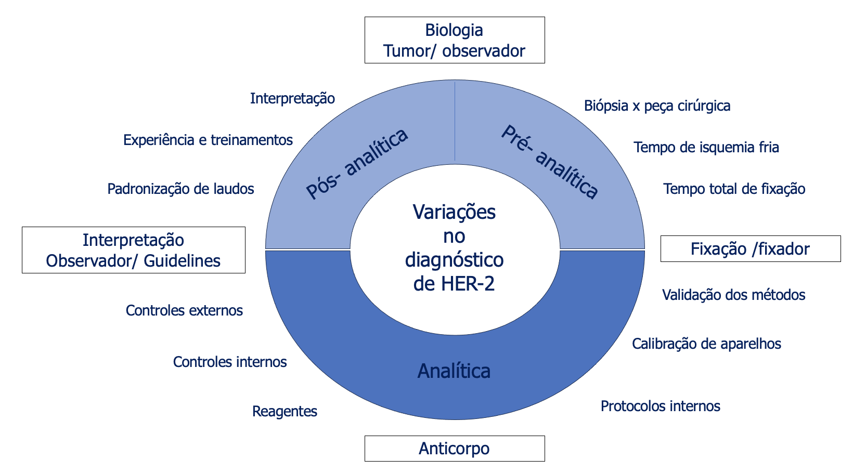
Variações no diagnóstico de HER-2
Slide do autor
Notes:
Bx x peça: representação tumoral

Slide 24
Guidelines e recomendações de experts
Tipo tumoral | Testagem de HER-2 |  | Frequência de testagem
 | Teste | Recomendação
Carcinomas serosos e carcinossarcomas de endométrio | Histologia/ IH/ ISH | ✓ | Recomendada para todos os carcinomas serosos, carcinossarcomas e carcinomas com p53 anormal independente da histologia
Carcinomas ovarianos | Histologia/ IH/ ISH | ✓ | Considerar testagem em doença recorrente ou resistente a tratamento
Carcinomas de colo uterino | Histologia/ IH/ ISH | ✓ | Recomendada para carcinomas em estadiamento avançado, recorrentes ou metastáticos
NCCN. Clinical practice guidelines in oncology: uterine neoplasms. v.2.2024. nccn.org.
NCCN. Clinical practice guidelines in oncology: ovarian cancer. v.1.2024. nccn.org.
NCCN. Clinical practice guidelines in oncology: cervical cancer. v.1.2024. nccn.org.
Notes:
Bx x peça: representação tumoral

Slide 25
Questões práticas remanescentes
Correlação com resposta clínica (IH x ISH)
Impacto clínico de guidelines: mama (2007, 2013, 2018) x gástrico x ginecológico específico (?)
Avaliação em cenários de heterogeneidade tumoral e pós tratamento
Seleção de amostra:
  Biópsias x peça (quantos blocos?)
  Primário x metástase
Cuidados com amostra: tempos de isquemia fria e fixação total ~ mama?

Slide 26
Perspectivas futuras
Expressão proteica de HER-2 apresenta características distintas em diferentes tumores de diferentes órgãos
Estudo cuidadoso para melhor seleção de pacientes elegíveis ao tratamento
Estudos futuros são necessários e esperados para resolver questões práticas e refinar algoritmos de interpretação
Auxílio da inteligência artificial

Slide 27





karla.prigenzi@einstein.br
@pathology_tips

